Slide 1
Selenium + Java Training
Trainer – Nikunj Shah

Slide 2
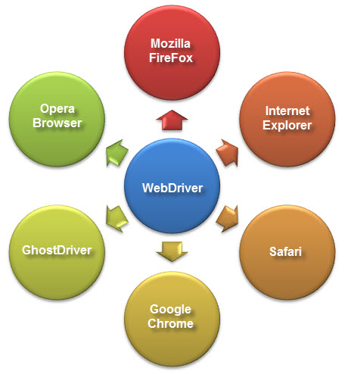
What is Selenium Webdriver?
Selenium Webdriver is an open-source collection of APIs which is used for testing web applications.
The Selenium Webdriver tool is used for automating web application testing to verify that it works as expected or not.
It mainly supports browsers like Firefox, Chrome, Safari and Internet Explorer. It also permits you to execute cross-browser testing.

Slide 3
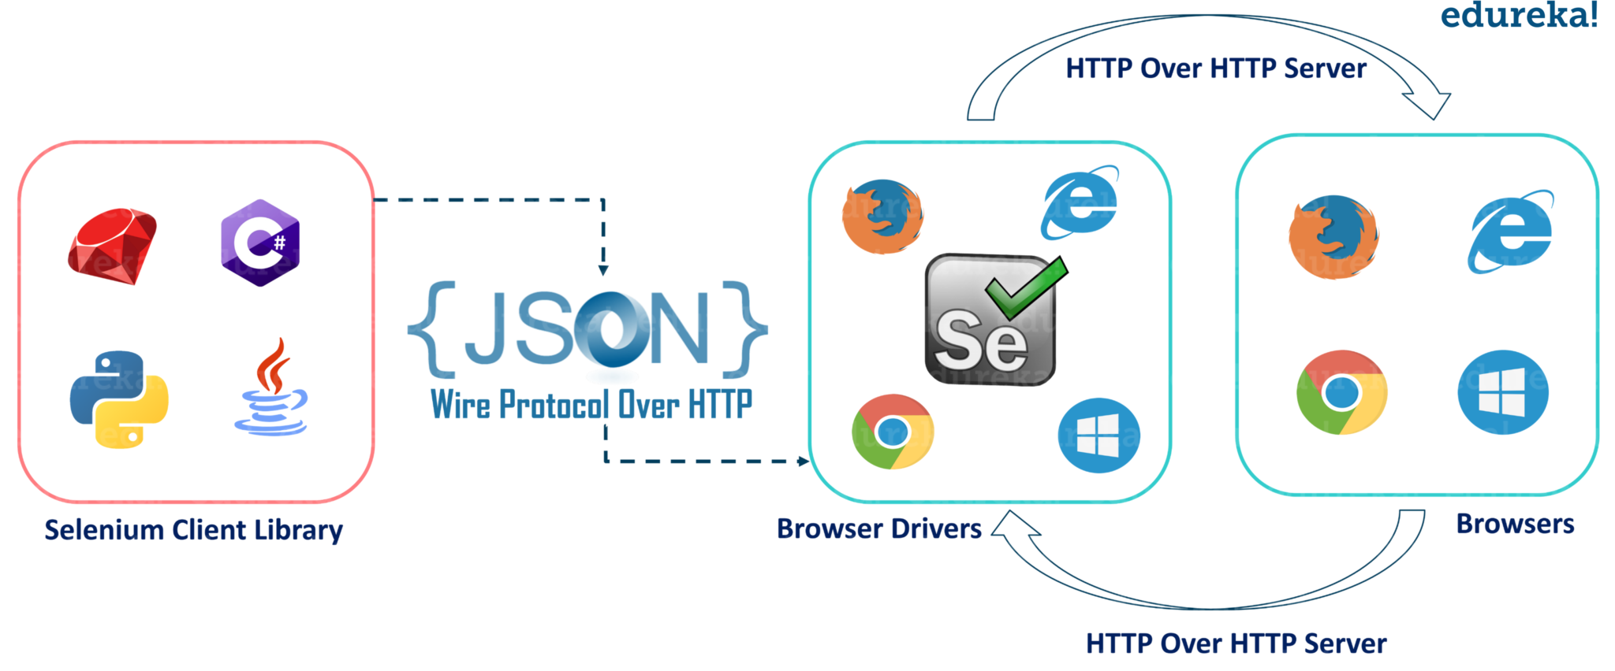
Architecture

Slide 4
Architecture
Selenium Client Libraries/Language Bindings
Selenium supports multiple libraries such as Java, Ruby, Python, etc. Selenium Developers have developed language bindings to allow Selenium to support multiple languages. If you wish to know more about libraries, kindly refer to the official site for Selenium libraries.
JSON WIRE PROTOCOL Over HTTP Client
JSON stands for JavaScript Object Notation. It is used to transfer data between a server and a client on the web. JSON Wire Protocol is a REST API that transfers the information between HTTP server. Each BrowserDriver (such as FirefoxDriver, ChromeDriver, etc.) has its own HTTP server.
Browser Drivers
Each browser contains a separate browser driver. Browser drivers communicate with the respective browser without revealing the internal logic of the browser’s functionality

Slide 5
Types of WebElements
Edit box
Link
Button
Image, image link, an image button
Text area
Checkbox
Radio button
Dropdown list

Slide 6
Types of Operations
Operations performed on the browserLaunch the browser
Navigate to particular web page
Close the current browser
Close all browsers opened by WebDriver during execution
Maximize browser
Refresh the browser
Operations on the web page
Get page title
Get page URL
Operations on edit box
Enter a value
Get the value
Clear the value

Slide 7
Types of Operations
Operations on link
Click the link
Return the link name
Operations on button
Click enabled
Display status
Operations on text area
Return or capture the messages from the web page
Operations on checkbox
Select the checkbox
Unselect the checkbox
Operations on radio button
Select radio button
Check if it displays the radio button
Operations on drop down
Select an item in the list
Get the item count

Slide 8
Sample Program
public static void main(String[] args) throws InterruptedException {
System.setProperty("webdriver.chrome.driver", "Chromechromedriver.exe");
WebDriver driver = new ChromeDriver();
driver.get("<a href="https://www.amazon.in/">https://www.amazon.in/</a>");
driver.manage().window().maximize();
Thread.sleep(4000);
driver.findElement(By.id("twotabsearchtextbox")).sendKeys("Poco F1");
Thread.sleep(4000);
driver.findElement(By.className("nav-input")).click();
driver.findElement(By.linkText("ACM")).click();
driver.navigate().to("<a href="http://edureka.co/blog">http://edureka.co/blog</a>");
Thread.sleep(4000);
driver.navigate().back();
driver.quit();
}

Slide 9
Locators in WebDriver
Locator is a command that tells Selenium IDE which GUI elements ( say Text Box, Buttons, Check Boxes etc) its needs to operate on.
Identification of correct GUI elements is a prerequisite to creating an automation script. But accurate identification of GUI elements is more difficult than it sounds. Sometimes, you end up working with incorrect GUI elements or no elements at all!
The choice of locator depends largely on your Application Under Test.

Slide 10
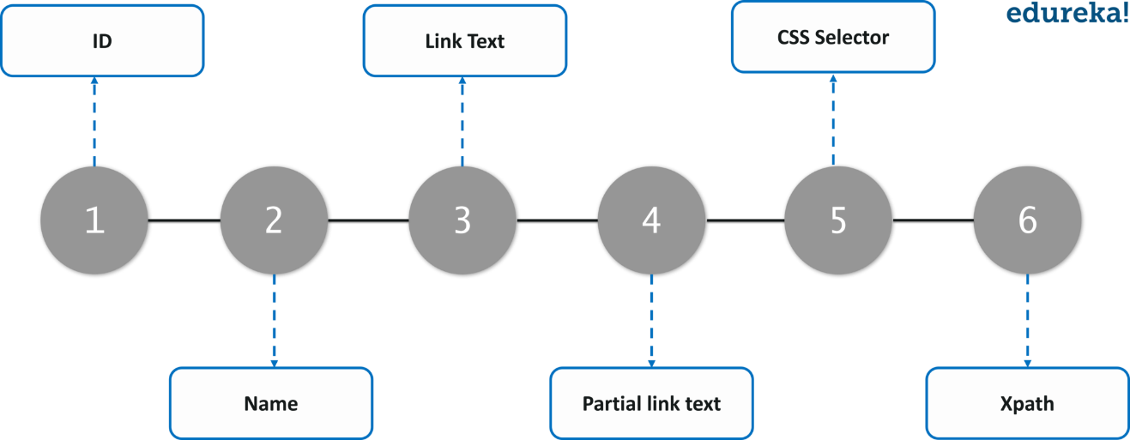
Locators in WebDriver

Slide 11
Locating by ID
This is the most common way of locating elements since ID's are supposed to be unique for each element.
Target Format: id=id of the element
WebElement elmement = driver.findElement(By.id("pt1:_UIShome::icon"));

Slide 12
Locating by Name and Class Name
Locating elements by name are very similar to locating by ID, except that we use the "name=" prefix instead.
Target Format: name=name of the element
WebElement elm = driver.findElement(By.name("name"));
WebElement links = driver.findElements(By.className("svg-bkgd01 xi8"));

Slide 13
Locating by LinkText & Partial LinkText
This type of locator applies only to hyperlink texts. We access the link by prefixing our target with "link=" and then followed by the hyperlink text.
Target Format: link=link_text
driver.findElement(By.linkText(<link_text>)) ;//single web element
driver.findElement(By.partialLinkText(<link_text>)) ;//single web element

Slide 14
Locating by CSS Selector - Tag and ID
css=tag#id | tag = the HTML tag of the element being accessed # = the hash sign. This should always be present when using a CSS Selector with ID id = the ID of the element being accessed
WebElement el = driver.findElement(By.cssSelector("input#id));

Slide 15
Locating by CSS Selector - Tag and class
css=tag.class | tag = the HTML tag of the element being accessed . = the dot sign. This should always be present when using a CSS Selector with class class = the class of the element being accessed
WebElement el = driver.findElement(By.cssSelector("input.x25"));

Slide 16
Locating by CSS Selector - Tag and attribute
css=tag[attribute=value] | tag = the HTML tag of the element being accessed [ and ] = square brackets within which a specific attribute and its corresponding value will be placed attribute = the attribute to be used. It is advisable to use an attribute that is unique to the element such as a name or ID. value = the corresponding value of the chosen attribute.
WebElement el = driver.findElement(By.cssSelector("input[name=‘value']"));

Slide 17
Locating by CSS Selector - Substring matches
Starts with –
WebElement el = driver.findElement(By.cssSelector("input[name^='pt1:r1:0:rt']"));
Ends with –
WebElement el = driver.findElement(By.cssSelector("input[name$='1:AP1:inputText562']"));
Contains
WebElement el = driver.findElement(By.cssSelector("input[name*='AP1']"));

Slide 18
Summary
Method | Target Syntax | Example
By ID | id= id_of_the_element | id=email
By Name | name=name_of_the_element | name=userName
By Name Using Filters | name=name_of_the_element filter=value_of_filter | name=tripType value=oneway
By Link Text | link=link_text | link=REGISTER
Tag and ID | css=tag#id | css=input#email
Tag and Class | css=tag.class | css=input.inputtext
Tag and Attribute | css=tag[attribute=value] | css=input[name=lastName]

Slide 19
Locating by XPath
XPath in Selenium is an XML path used for navigation through the HTML structure of the page.
It is a syntax or language for finding any element on a web page using XML path expression.
XPath can be used for both HTML and XML documents to find the location of any element on a webpage using HTML DOM structure.
Syntax for XPath:
Xpath=//tagname[@attribute='value']

Slide 20
Types of XPath
There are two types of XPath:
1) Absolute XPath
2) Relative Xpath
Absolute XPath:
/html/body/div[2]/div[1]/div/h4[1]/b/html[1]/body[1]/div[2]/div[1]/div[1]/h4[1]/b[1]
Relative Xpath:
//div[@class='featured-box cloumnsize1']//h4[1]//b[1]

Slide 21
Using XPath
Basic XPath:
Xpath=//input[@type='text']
Xpath= //label[@id='message23']
Xpath= //input[@value='RESET']
Xpath=//*[@class='barone']
Xpath=//a[@href='http://demo.guru99.com/']
Xpath= //img[@src='//cdn.guru99.com/images/home/java.png']

Slide 22
Using XPath
Contains():
Xpath=//*[contains(@type,'sub')]
Xpath=//*[contains(@name,'btn')]
Xpath=//*[contains(@id,'message')]

Slide 23
Using XPath
Using OR & AND:
Xpath=//*[@type='submit' or @name='btnReset']
Xpath=//input[@type='submit' and @name='btnLogin']

Slide 24
Using XPath
Xpath Starts-with
Xpath=//label[starts-with(@id,'message')]
XPath Text() Function
Xpath=//td[text()='UserID']

Slide 25
Form Elements
Element | Command | Description
Input Box | sendKeys() | used to enter values onto text boxes
 | clear() | used to clear text boxes of its current value
Links, Radio Button, Checkboxes | click() | used to click on the link and wait for page load to complete before proceeding to the next command.
Submit Button | submit()

Slide 26
DropDown Value Selection
selectByVisibleText()
selectByValue()
selectByIndex()
Select drpCountry = new Select(driver.findElement(By.name("country")));
drpCountry.selectByVisibleText("ANTARCTICA");

